Slide 1

#CodeToImpact 2023
Alpha Analytica
Team 2

Slide 2




Meet Our Team
NGOC
Quarter-Stack Developer
SISHI
Quarter-Stack Developer
G WAYNE
Quarter-Stack Developer
FU WEN
Quarter-Stack Developer
Full-Stack Developer

Slide 3
Agenda
Problem Statement
What is Alpha Analytica
Assumptions
Solution Architecture
System Design
Challenges
Learning Points
Future Work
Demo

Slide 4
Problem Statement
How might we help senior managers have better control and insights into investment assets?

Slide 5
What is
Alpha Analytica

Slide 6
Alpha Analytica
Keep track of securities
Analytics on investments
Queries across datasets

Slide 7
Assumptions
Monthly ingestion
Queries on aggregated data
New data will be ingested into Alpha Analytica at the end of every month
Users can gain more insights into aggregated data on country, instrument and sector

Slide 8




Solution Architecture
Frontend
Application
Database

Slide 9
System Design
DocumentDB
Positions
Entities
Data Source
.csv
.db
Analytics
GenAI
Ingestor
Notes:
Thanks Ngoc, i’ll now be sharing on our system design. When our endpoint is triggered, it ingests and cleans all the input files and inserts it to DocumentDB -- that Positions, Entities and Analytics all rely on. Lastly, our GenAI chatbot will ideally use our analytics endpoint. However, we built but did not connect the endpoints.

Slide 10

GenAI
Analytics Data
User query
Notes:
Both our analytics data and user query are made into a prompt, and it is fed to our anthropic chatbot.

Slide 11


Basic Queries
What is the market value for the market value ID of 1?
The market value for the market value ID of 1 is $100000000.
Notes:
For example, the user could send the query, “what is the market value for the market value ID of 1?”. And our chatbot will return, “the market value for the market value ID of 1 is $100 million. Unfortunately, OpenAI’s API is off the table, so we were not able to use the extensive functionalities in the langchain library for OpenAI such as creating a csv agent that is able to pull off complex queries.

Slide 12



Challenges
Mastering AWS Fundamentals Under Time Constraints
Resolving GitHub Merge Conflicts
Complex Project Scaling
Notes:
Throughout this hackathon, we faced many challenges such as:- mastering aws fundamentals for deployment under a short timeline - resolving GitHub merge conflicts that resulted in overwriting of features- and complex project scaling where we lacked sufficient time

Slide 13

Learning Points
Allocate work and stay on the same page from the start
Start with System Design
Integrate early
Notes:
Retrospectively, we would've started with system design, which would help us to allocate work and stay on the same page better. And lastly, it would be to integrate early.

Slide 14
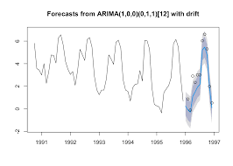
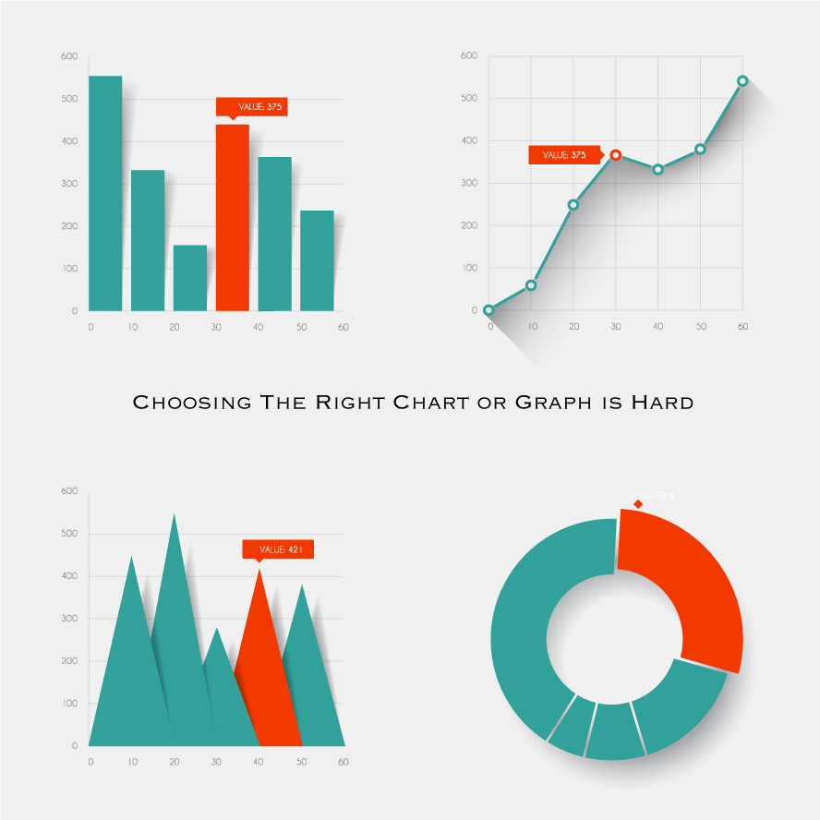
Future Work
ARIMA/LSTM Predictor
Custom visualisations from Chatbot
Text to Queries Chatbot
Notes:
In the future, we're planning to integrate our ARIMA/LSTM predictor endpoint that's able to help us forecast the prices of our securities. Custom visualisations from our chatbot by utilising pandas ai, and to deploy our endpoint for the chatbot to take in data.

Slide 15
Demo

